Slide 1

Gradually interpretable models via component-wise boosting
Master Thesis
Lorenz Haller
28.10.19

Slide 2
Benchmark Procedure
Built two mlr-wrappers for regression and two-class classification
First benchmark to decide on hyperparameters ε, ν and on the method used in the second stage (tree stumps or splines)
Then benchmark to compare own method with other learners:
5 tasks for regression and for classification

Slide 3
Choice of hyperparameters (as default)
ε (epsilon) – minimal needed improvement between one iteration and the next
ν (nu) – shrinkage parameter / step size
btree vs. bbs: Should splines or tree stumps be used in the second stage?

Slide 4
Notation
method _ nu _ epsilon
btree (tree stumps) vs. bbs (p-splines)
Minimal improvement parameter epsilon:
0.05 vs. 0.01 vs. 0.005 vs. 0.001
Choice of shrinkage parameter nu:
0.1 vs 0.05

Slide 5
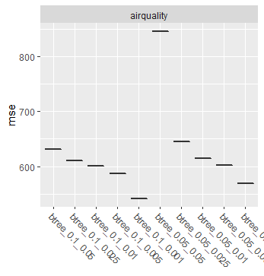
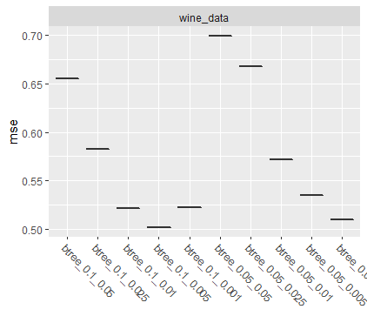
Choice of ε / nu
method _ nu _ epsilon

Slide 6
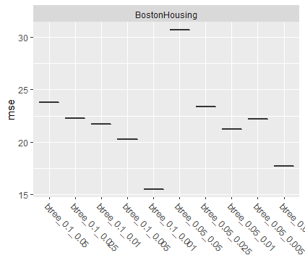
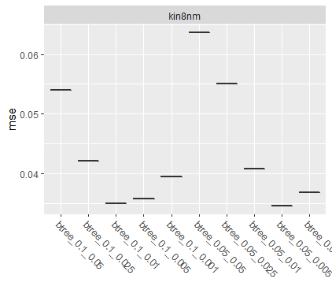
Choice of ε / nu
method _ nu _ epsilon

Slide 7
Choice of ε / nu
Choice for nu:
0.1
Choice for ε :
0.005

Slide 8
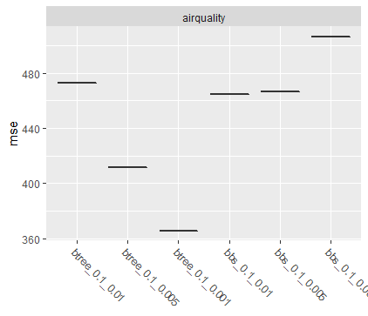
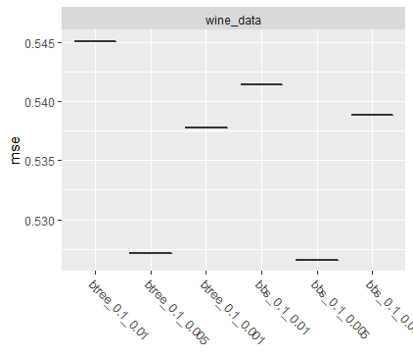
Choice of method: btree vs bbs

Slide 9
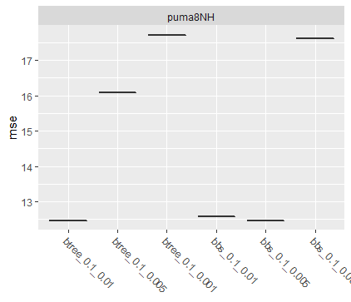
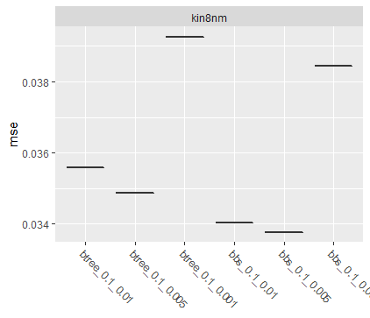
Choice of method: btree vs bbs

Slide 10
Choice of method: btree vs bbs
No clear advantage of one of the two methods
Choose btree (tree stumps) as default
Because: bbs (p-splines) has problems with some tasks, e.g. BostonHousing

Slide 11
Benchmark Regression
Learners in the Benchmark:
regr.icb: Our new method “Interpretable Component-wise Boosting”
regr.lm: Simple linear regression
regr.gamboost: Gamboost from mboost- package
regr.glmboost: Boosting for GLMs from mboost-package
regr.rpart: Decision Tree
regr.gbm: Gradient Boosting from gbm-package
regr.svm: Support Vector Machines
regr.randomForest: Random Forests

Slide 12
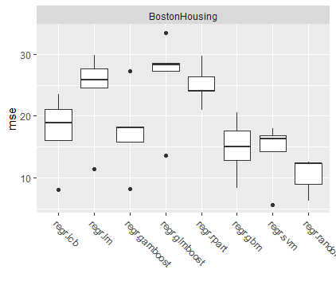
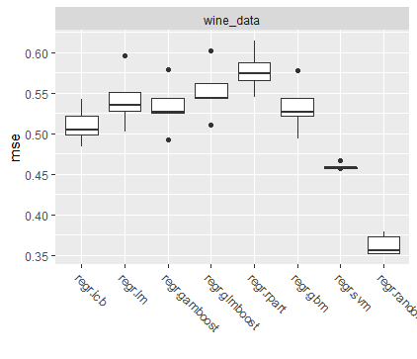
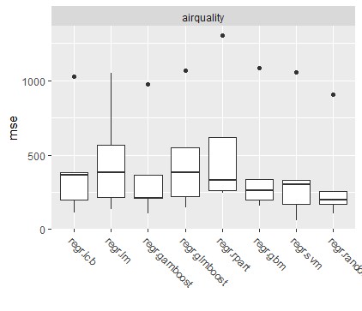
Benchmark Regression using five-fold cross-validation

Slide 13
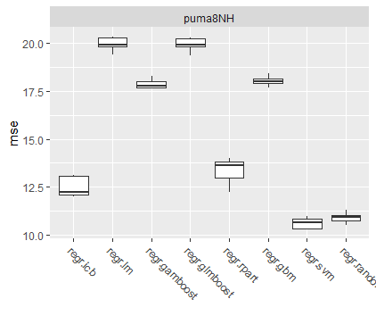
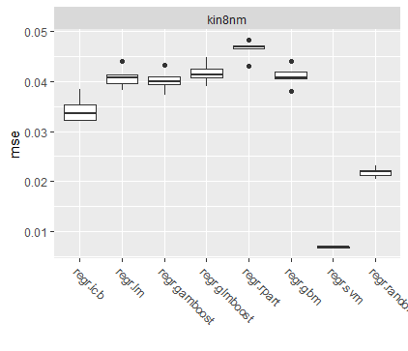
Benchmark Regression using five-fold cross-validation

Slide 14
Overview Regression Benchmark
Overview Mean MSE from five-fold cross-validation
 | icb | lm | gamboost | glmboost | rpart | gbm | svm | random Forest | Number of features | Number of numeric features
Boston Housing | 15.9 | 23.0 | 16.7 | 25.6 | 21.3 | 14.3 | 13.3 | 10.4 | 13 | 12
Wine | 0.512 | 0.542 | 0.533 | 0.552 | 0.581 | 0.534 | 0.462 | 0.365 | 12 | 12
Airquality | 416 | 469 | 373 | 471 | 551 | 408 | 384 | 326 | 5 | 3
puma8NH | 14.0 | 19.9 | 17.9 | 19.9 | 13.1 | 18.0 | 10.7 | 10.9 | 9 | 9
kin8nm | 0.035 | 0.041 | 0.040 | 0.042 | 0.047 | 0.041 | 0.007 | 0.022 | 9 | 9

Slide 15
Classification Regression
Learners in the Benchmark:
classif.icb: Our new method “Interpretable Component-wise Boosting”
classif.binomial: Binomial regression
classif.glmboost: Boosting for GLMs from mboost-package
classif.rpart: Decision Tree
classif.gbm: Gradient Boosting from gbm- package
classif.svm: Support Vector Machines
classif.randomForest: Random Forests
classif.ada: ada Boosting
classif.kknn: k-Nearest Neighbor

Slide 16
Benchmark Classification using five-fold cross-validation

Slide 17
Benchmark Classification using five-fold cross-validation

Slide 18
Overview Classification Benchmark
Overview Mean MMCE from five-fold cross-validation
 | icb | Binomial | glmboost | rpart | gbm | ada | kNN | svm | random Forest | Number of features | Number of numeric features
spam | 0.062 | 0.075 | 0.142 | 0.111 | 0.070 | 0.050 | 0.079 | 0.067 | 0.048 | 57 | 57
credit | 0.286 | 0.246 | 0.242 | 0.269 | 0.249 | 0.241 | 0.273 | 0.268 | 0.228 | 21 | 7
electricity | 0.205 | 0.282 | 0.241 | 0.237 | 0.227 | 0.178 | 0.159 | 0.208 | 0.105 | 9 | 7

Slide 19
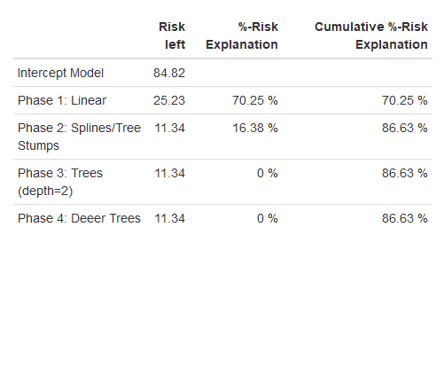
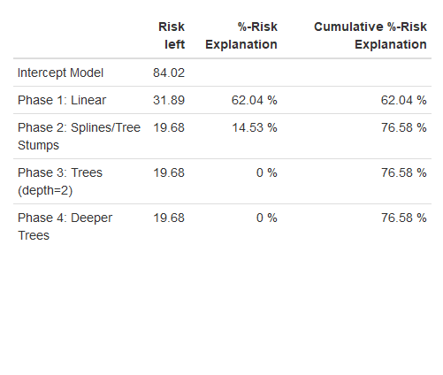
Explainer Table
stage_risk(micb_object = micb_wrapper)
stage_risk(pred_object = pred)

Slide 20
Partial Dependence Plots for Airquality data, using tree stumps

Slide 21
Risk Plots including a feature counter

Slide 22

End

Slide 23
Zusammenfassung der Arbeit
Mehrstufiges Verfahren unter Verwendung von Componentwise Boosting
Aktuell drei Phasen, hart voneinander getrennt:
Lineare Komponenten (lineares Modell)
Nicht-lineare Komponenten (über Splines)
Feature Interaktionen (Trees (oder zweidim. Splines denkbar))

Slide 24
Zusammenfassung der Arbeit
Übergang zwischen den Phasen über eine minimal notwendige Verbesserung des Risikos von einer Phase auf die nächste
ꜫ
Eine Phase läuft, solange der Quotient aus dem Risiko einer Iteration und dem Risiko aus der Iteration davor größer als ꜫ ist:
while((iteration <= mstop) & (risk[iteration-1]/risk[iteration] >= 1+ꜫ )){
…
}

Slide 25
Pseudo-Code: Initialisierung
interpretable_comp_boost_m <- function(data, formula, nu=0.05, mstop=200, family=Gaussian(), epsilon = 0.0025){
…
ngradient <- family@ngradient
riskfct <- family@risk
…
Fit intercept model as initial fit and calculate risk
intercept_model <- lm.fit(x=X[,1]), y=y)
fit_0 <- intercept_model$fitted.values
risk_0 <- riskfct(y = y, f = fitted_values)
lm_coeffs = numeric(dim(X)[2])
lm_coeffs[1] <- intercept_model$coefficients[1]

Slide 26
Pseudo-Code: Phase I: Linear Models
while((iteration <= mstop) & ((risk[iteration-1]/[iteration]) >= (1 + epsilon))){
risk_temp <- riskfct(y = y, f = fitted_values)
u <- ngradient(y = y, f = fitted_values)
lm_coeffs_temp = numeric(dim(X)[2])
for(feat in 1:dim(X)[2]){
bl_model <- lm.fit(x=X[,feat], y=u)
lm_fit[feat] <- riskfct(y=u, f=bl_model$fitted.values)
pred_matrix[,feat] <- bl_model$fitted.values
lm_coeffs_temp[feat] <- bl_model$coefficients
}

Slide 27
Pseudo-Code: Phase I Linear Models
model_select <- which.min(lm_fit)
lm_coeffs[model_select] <- lm_coeffs[model_select] + nu * lm_coeffs_temp[model_select]
fitted_values <- X_scaled_lin %*% lm_coeffs
risk[iteration+1] <- riskfct(y = y, f = fitted_values)
}

Slide 28
Pseudo-Code: Phase II Splines
data_temp[,target] <- ngradient(y = y, f = fitted_values)
while((iteration <= mstop) & ((risk_temp / risk_iter[iteration+1]) >= (1 + epsilon))){
risk_temp <- riskfct(y = y, f = fitted_values)
u <- ngradient(y = y, f = fitted_values)
mb_spline = mboost::gamboost(formula = formula, data = data_temp, family = family, baselearner = "bbs", control = boost_control(nu = nu, mstop = 1))

Slide 29
Pseudo-Code: Phase II Splines
mboost_coeff = mb_spline$coef()[[1]]
mboost_risk = mb_spline$risk()[2]
coeff_list[[mboost_feature]] <- coeff_list[[mboost_feature]] + mboost_coeff
fitted_values <- fitted_values + mb_spline$fitted()
risk[iteration+1] <- riskfct(y = y, f = fitted_values)
data_temp[,target] <- ngradient(y = y, f = fitted_values)
}

Slide 30
Pseudo-Code: Phase III Trees
while((iteration <= mstop) & ((risk[iteration]/risk[iteration+1]) >= (1 + epsilon))){
risk_temp <- riskfct(y = y, f = fitted_values)
u <- ngradient(y = y, f = fitted_values)
mb_tree = mboost::mboost(formula = formula, data = data_temp, family = family, baselearner = "btree", control = boost_control(nu = nu, mstop = 1))
mboost_risk = mb_tree$risk()[2]
fitted_values <- fitted_values + mb_tree$fitted()
data_temp[,target] <- ngradient(y = y, f = fitted_values)

Slide 31
Pseudo-Code: Return List
return_list <- list()
return_list[["Coefficients"]] <- coeff_list
return_list[["Fitted_Values"]] <- fitted_values
return_list[["Transition Iterations"]] <-c(transition_splines,transition_trees)
return_list[["Risk"]] <- risk_iter
return_list[["Prediction_Models"]]<- c(linear_coefficients,spline_coefficients,tree_models)
return_list[["Input_Parameters"]] <-c(nu, mstop, epsilon)
return_list[["Riskfunction"]] <- riskfct
return(return_list)

Slide 32
Pseudo-Code: predict-Funktion
icb_predict <- function(icb_object, newdata, target){
prediction <- vector(mode = "numeric", length = dim(newdata)[1])
for (l in 1:length(prediction)){
prediction[l] <- icb_object$Coefficients$Intercept[[1]]
}
while(iteration <= (icb_object$`Transition Iterations`[1]+1)){
pred_iteration <- newdata[,selected_feature] * icb_object$Prediction_Models[[iteration]][pos_feature]
prediction <- prediction + nu * pred_iteration
test_risk[iteration+1] <- icb_object$Riskfunction(y = y, f = prediction) }

Slide 33
Pseudo-Code: predict-Funktion
while(iteration <= (icb_object$`Transition Iterations`[2]+1)){
mboost_spline_model <- icb_object$Prediction_Models[[iteration]]
pred_iteration <- mboost_spline_model$predict(newdata)
prediction <- prediction + pred_iteration
test_risk[iteration+1] <- icb_object$Riskfunction(y = y, f = prediction)
}
while(iteration < length(icb_object$Risk)){
mboost_tree_model <- icb_object$Prediction_Models[[iteration]]
pred_iteration <- mboost_tree_model$predict(newdata)
prediction <- prediction + pred_iteration
test_risk[iteration+1] <- icb_object$Riskfunction(y = y, f = prediction)
}

Slide 34
Pseudo-Code: predict-Funktion
return_list <- list()
return_list[["Predictions"]] <- prediction
return_list[["TestRisk"]] <- test_risk
return(return_list)
}

Slide 35
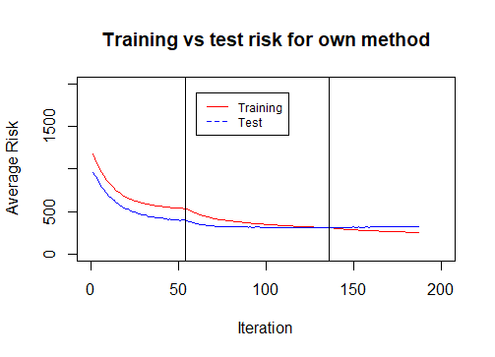

Slide 36
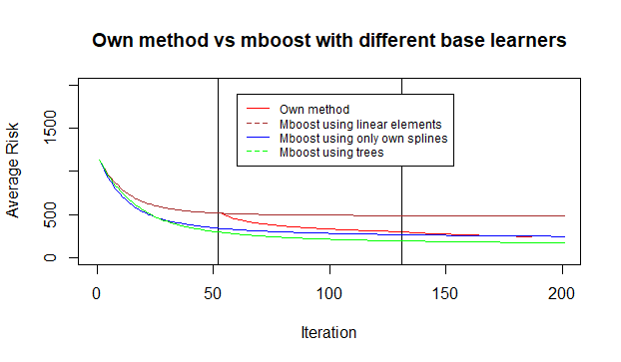

Slide 37

To-Do’s
Visualisierung verschiedener Kennzahlen im Verlauf der Zeit / des Risks: Anzahl der Features, Anzahl der Interaktionen, Nicht-Linearität der Effekte
Outputkurven zum Vergleich der Effekte über die drei Phasen
Partial Dependence Plots
Reduzierung der Größe der von mboost gespeicherten Daten/Modelle
Phase 0 mit Penalty für neue Features

Slide 38
Outline
Motivation:
Importance of Interpretability (so far mainly focus on accuracy…)
Demand for methods that combine accuracy and interpretability
2. Related Work:
„Technical“ Comparison to similar methods (Linear Model, Lasso, GA2M, GAMBoost, .. ) from practice and literature using different metrics (Performance, Sparsity, Interpretability)
3. Introduction to Gradient Boosting and Componentwise Boosting

Slide 39
Outline
Introduction of own method
Idea behind
Implementation Details (Three Phases/Steps, Choice of base learners, Stop Criterion)
Benchmark Study
Different data sets (Regression/Classification, Few/many features, Good/bad performance)
Different parametrizations of own method
Comparison to different other methods (that also adress the issue of interpretability?)

